Slide 1
PRESENTATION ON FTP(File Transfer Protocol)

Slide 2
CONTENTS
Introduction
Role of FTP
Example & Application
FTP Model
Commands

Slide 3
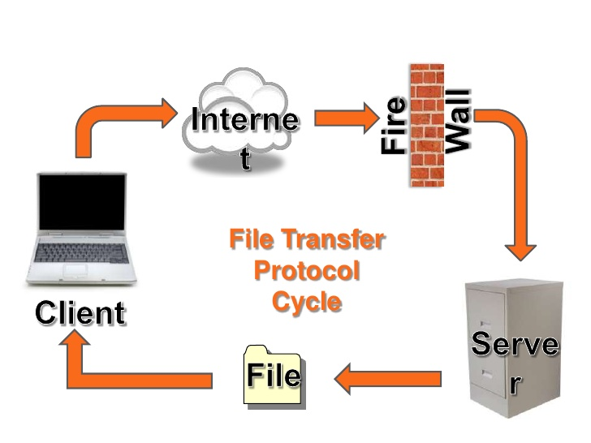
Introduction
A protocol for transferring files in the Internet’s TCP/IP protocol
Simplest & most secure way to exchange files over Internet
Uploading :from client computer to server
Downloading :from server computer to client
Doesn’t really move instead copy files
Operates in client/server environment

Slide 4
Role of FTP
allow file sharing between remote machines
allow independence between client and server machine system files
enable efficient data transfer

Slide 5
Example of FTP
FileZilla : windows, Macintosh & Linux users
Fire FTP : plug-in for the popular firefox browser
Dreamweaver : page layout/design program
Applications
Downloading MP3
Online games
Auctions & online trading
Transferring web page files from creator to computer

Slide 6
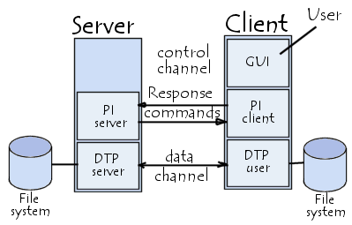
FTP model

Slide 7
Commands
Access control commands(USER, PASS, ACCT, CWD, CDUP, QUIT, REIN, SMNT)
Transfer parameter commands(PORT, PASV, TYPE, STRU, MODE)
FTP service commands(RETR, STOR, STOU, APPE, ALLO, REST, RMD, MKD, LIST, DELE, STAT)

Slide 8
THANK YOU

